Slide 1
PL-600 Power Virtual Agents Architecture

Slide 2
Agenda
Discuss options for chatbots
Review key concepts and considerations for deploying Power Virtual Agents
Integrating Power Virtual Agents with other services
Power Virtual Agents in Microsoft Teams
Notes:
Chatbots are becoming an increasingly important component of business applications. Understanding the capabilities of Power Virtual Agents is required when designing a Microsoft Power Platform solution.
This module is concerned with Power Virtual Agents and its capabilities.
In this module, you will:
- Explore options for chatbots and how to choose where to start.
- Explore scenarios for chatbots.
- Understand the components of Power Virtual Agents.

Slide 3

Concepts
Notes:
When creating chatbots there are some import concepts to understand before building your chatbot.

Slide 4
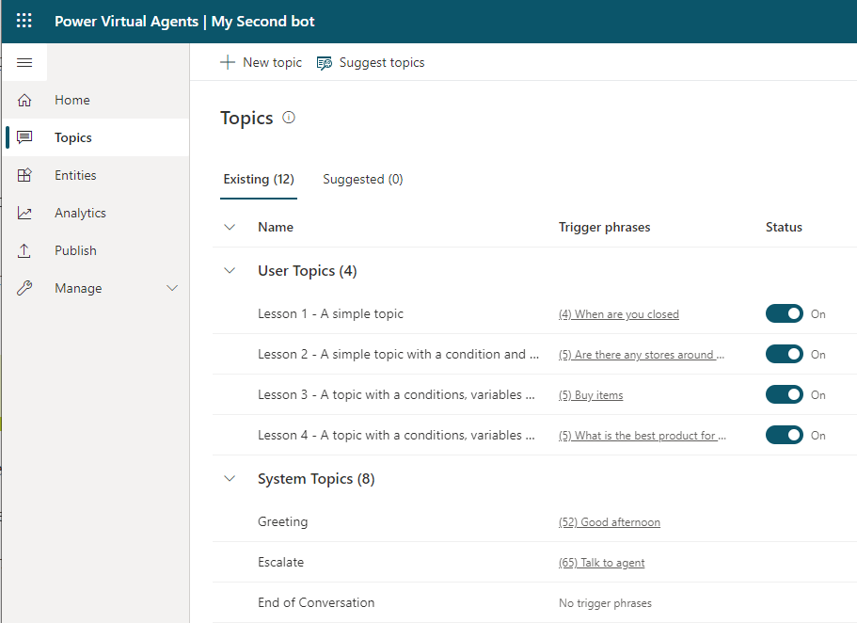
Topics
Conversation paths
Conversations
Trigger phrases
Conversation nodes
Uses natural language understanding (NLU) model
Notes:
Power Virtual Agents work by identifying the subject that the user is asking about and then having a conversation about that subject.
Topics are the main subjects of the conversation. A Power Virtual Agents chatbot can have up to 1,000 topics. Each topic is a separate conversation path. It is the combination of topics in a chatbot that provides a natural conversational flow. You create topics for the tasks or requests that you need your chatbot to respond to.
Topics define the purpose of your chatbot and are the first step in authoring your chatbot. A topic has two parts:
- Trigger phrases: The keywords, phrases, or utterances that the user will enter
- Conversation nodes: How your bot should respond
Each topic has its own conversation flow with the bot. When a bot identifies a trigger for a topic, the conversation for that bot is initiated.
The use of the natural language understanding (NLU) model means that in Power Virtual Agents, when you craft trigger phrases for a topic, you only need to provide a few examples, usually in the range of five to ten phrases for a single topic. Shorter trigger phrases are better, and you should aim for two to ten words. You just need to make sure trigger phrases are semantically different: changing a single verb or noun could be enough to expand a topic's coverage. Adding things like new articles (changing or adding 'the' or 'a' or 'an'), changing capitalization, adding contractions (you're or don't), or adding plurals won't improve the triggering because contractions are already accounted for in the natural language understanding model.
Many organizations will have procedures, product information, frequently asked questions, and other information in documents or on websites. Power Virtual Agents can extract information and create topics with trigger phrases using the Suggest topics option.
If you are using Dynamics 365 Customer Service Insights, you can select the topics from within Customer Service Insights and add the topics and trigger phrases to your Power Virtual Agent chatbot.

Slide 5
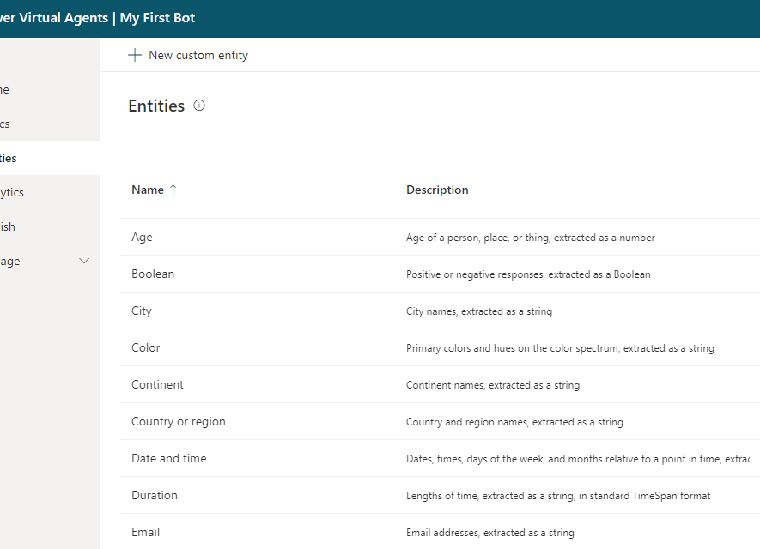
Entities
Extract information
Help identify what the user is asking about
Control conversation path
Pre-built entities
Custom entities
Notes:
Power Virtual Agents attempts to extract information from the phrases entered by the user. This extracted information can be used to control the conversation's path. Power Virtual Agents uses entities to identify information in a textual phrase, for instance, names, dates, and numbers. Your chatbot can then use this information to decide on the appropriate next step in the conversation.
Entities are people, places, and things that a chatbot can identify from the phrases entered into a chatbot. Power Virtual Agents includes a set of pre-built entities for the most commonly used objects and you can create custom entities for the domain of the business solution you are building.

Slide 6
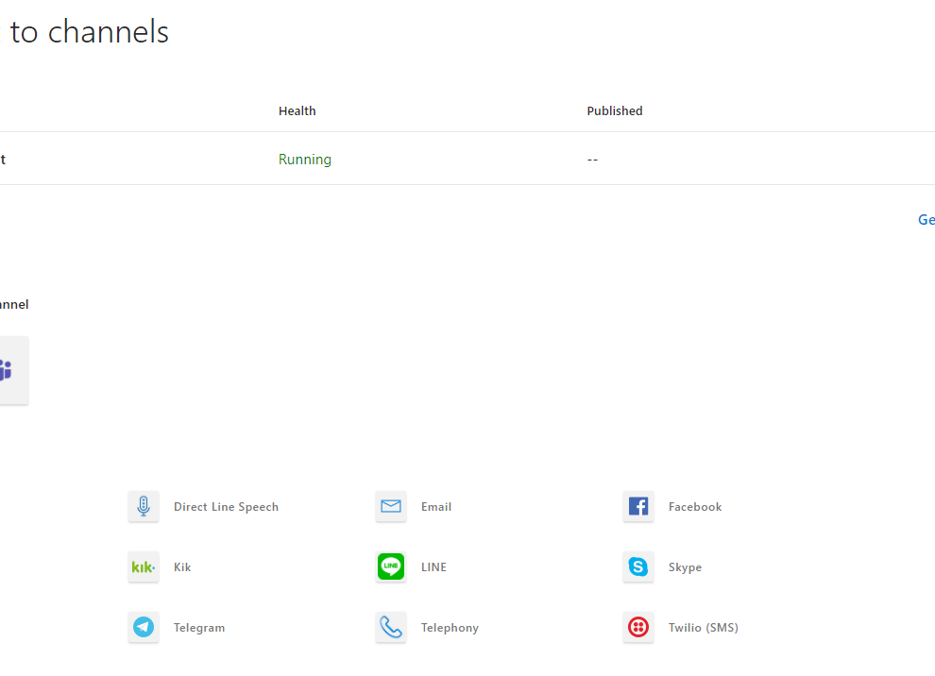
Channels
Distribute chatbots
Provided by Azure Bot Framework
Automatically adjust format to the channel’s service
Web only by default
Notes:
The Azure Bot Framework separates the logic of the bot from the communication with different services. When you create a bot, the bot is only available for use embedded on websites with the Web Chat channel. You can add channels to your bot to make the bot available on other platforms and services, known as channels.
One of the major benefits of the Azure Bot service is that you develop your bot once and connect to multiple channels without needing to change the code for each channel to handle the specific requirements and formats of that channel. The Azure Bot Service takes care of those requirements and converting the formats.
The following channels are available for connection to bots:
- Alexa
- Direct Line
- Direct Line Speech
- Email
- Facebook
- GroupMe
- Kik
- Line
- Microsoft Teams
- Skype
- Slack
- Telegram
- Telephone
- Twilio (SMS)
- Web Chat
Power Virtual Agents can be deployed to the same channels.

Slide 7

Best practice
Notes:
Best practice and considerations for deploying Power Virtual Agents
Chatbots, if used, are a very powerful tool for increasing customer interaction with your solution. A solution architect must ensure that the chatbots are correctly built and meet the requirements.
This section contains recommendations around designing and deploying chatbots.

Slide 8
Planning
Define the scope of the chatbot
Define the purpose of the chatbot
Define the channels for the bot
Define key metrics and success criteria
Verify topics and entities
Notes:
When planning a chatbot the solution architect should:
- Define the scope of the chatbot
- Define the purpose of the chatbot
- Define which channels the bot will be deployed to
- Define the key metrics and success criteria
- Verify the topics, entities, and conversational flows.
A chatbot supports three different types of topic:
- Informational
- Tasks
- Troubleshooting
A good Power Virtual Agents chatbot will have a high business impact i.e., a high level of traffic, a low level of integration complexity, and will achieve a high level of conversation completion without the need for escalation to a human agent.
A well designed chatbot will have a well defined set of goals. Each topic is linked to a business process and has trigger events, a clear set of rules, a set of documents, and a series of tasks that will be performed.
The solution architect may need to provide guidelines for creating topics and trigger phrases for chatbot authors to follow.

Slide 9
Escalations
Hand off conversations to live agents seamlessly and contextually
Requires an engagement hub
Solution architect determines when escalation should occur and how escalation will be handled
Notes:
With Power Virtual Agents, you can hand off conversations to live agents seamlessly and contextually.
When you hand off a conversation, you share the full history of the conversation (the context) as well as all user-defined variables. Having access to this context means live agents that are using any connected engagement hub can be notified that a conversation requires a live agent, see the context of the prior conversation, and resume the conversation.
You need to have an engagement hub that is being used by live agents, such as Omnichannel for Customer Service, and you need to configure the connection.
The solution architect should determine when escalation should occur and how escalation will be handled.
Power Virtual Agents chatbots come with telemetry built-in so that you can monitor how your chatbots are being used. Key KPIs are the rates of abandonment and escalation to a human agent. You should monitor your chatbots and change your chatbot to increase its effectiveness.

Slide 10
Authentication
Azure Active Directory
OAuth2
Single sign-on
Notes:
You can enable user authentication directly within a Power Virtual Agents bot conversation. User authentication means you can get a user's basic properties such as name and ID in bot variables, but also prompt a user to sign in using an authentication node, retrieve a user token for that user, and then use that token to retrieve the user's information from a back-end system.
Power Virtual Agents supports the following authentication providers:
- Azure Active Directory.
- Any identity provider that is compliant with the OAuth2 standard e.g., Microsoft Account or Facebook.
Power Virtual Agents supports single sign-on (SSO), which means chatbots can sign the user in if they're in to the page where the bot is deployed. You will need to register the web app in Azure Active Directory to enable SSO.
The solution architect should determine if authentication is required for bots and the identity provider used. In many situations, the organization may already have identity providers configured in Azure Active Directory. If creating chatbots for Microsoft Teams then this is simple to configure with the "Only for Teams" option, however if creating chatbots for customers you may need to consider Azure B2B and Azure B2C for authentication.

Slide 11
Considerations when deploying Power Virtual Agents
Solutions
Deployment
Power Virtual Agents are solution aware
Use Environment variables
Power Virtual Agents contain many sub-components that must be exported together
Post deployment manual actions required
Consider separate solution for Power Virtual Agents
Include actions in deployment plan
Notes:
Solutions
Power Virtual Agents are solution aware and can be included in solutions and application lifecycle management processes.
Bots contain many sub-components, such as Topics, that must all be exported and imported together. You should consider creating segmenting your solution and have bots and their sub-components separate in a separate solution from other components.
You can only import and export bots with the Power Virtual Agents web app. The feature is not available in the Power Virtual Agents app in Microsoft Teams.
Deployment
Power Virtual Agents are created in a selected environments. You should ensure that you are using the correct environment for development, test, and production purposes when creating chatbots.
If you are using skills, then you need to define environment variables for each skill.
Post deployment of your bot via a solution there are manual tasks that may need to be performed:
- Power Automate cloud flows: Configure any connections for the first time and visit the Power Virtual Agents portal and select the bot.
- Skills: Add the values for the skills’ environment variables.
- End-user authentication: Configure end-user authentication in the bot so it can take actions on the user’s behalf.
- Escalations: Configure external services that hand off bot escalations to a human agent.
- Multichannel: Configure external channels, such as Facebook, and internal non-Power Virtual Agents services, such as Microsoft Teams.
The solution architect should ensure that these steps are included in the deployment plan for the solution.

Slide 12

Integrating Power Virtual Agents
Notes:
This unit is about integrating Power Virtual Agents with other services
Power Virtual Agent chatbots will often require access to other services and systems to be able to complete their goals. Power Virtual Agents can also be integrated with other Microsoft AI services to create an enhanced customer experience.

Slide 13
Integration options
Power Automate
The primary integration method for Power Virtual Agent chatbots.
Use Power Automate to connect to other systems including Dataverse and Azure Cognitive Services.
Skills
Extend bots using Microsoft Bot Framework skills.
Add a Power Virtual Agents chatbot to an existing Azure Bot Framework bot
Use an Azure Bot Framework bot from within a Power Virtual Agent chatbot.
Bot Composer
Use Bot Framework Composer to create custom content and add it to Power Virtual Agents.
QnA Maker
Extend a Power Virtual Agents chatbot to provide answers from a QnA Maker knowledge base.
Add a fallback topic and use Power Automate to connects to a QnA Maker knowledge base.
Notes:
Power Automate
The primary integration for Power Virtual Agent chatbots is through Power Automate cloud flows.
Power Virtual Agents can pass parameters to a Power Automate cloud flow and receive data back from the flow and use that data in the chatbot's conversation flow. For instance, a chatbot may handle customer order updates and so will use a Power Automate cloud flow to fetch the order's status from the relevant system.
Power Automate cloud flows can be initiated from the all an action node in a topic.
Skills
Power Virtual Agents enables you to extend your bot using Microsoft Bot Framework skills. If there are existing Azure Bot Framework bots deployed, you can define those bots as a skill and embed the skill within a Power Virtual Agents bot. You can then use the Azure Bot Framework bot from within your Power Virtual Agent chatbot.
A developer can also use a Power Virtual Agent chatbot from an Azure Bot Framework bot. The Power Virtual Agent becomes the skill and the Microsoft Bot Framework dispatcher tool can integrate with the Power Virtual Agents bot.
The solution architect needs to oversee the design of bots and decide when to leverage existing bots and when to create new bots and with which toolset.
Bot Composer
Bot makers can use Bot Framework Composer to create custom content and add it to Power Virtual Agents.
For instance, by using Composer with your Power Virtual Agents chatbot you can:
- Show an Adaptive card.
- Use Bing Search as a fallback.
QnA Maker
You can extend a Power Virtual Agents chatbot to provide answers from a QnA Maker knowledge base. You need to add a fallback topic that uses Power Automate to run a cloud flow that connects to the QnA Maker via its connectors to respond to questions.
See https://docs.microsoft.com/azure/cognitive-services/qnamaker/tutorials/integrate-with-power-virtual-assistant-fallback-topic for the steps required. Consider demoing this is you have time
Cognitive Services
Azure Cognitive Services can be used by bots for a number of purposes such as:
- Sentiment analysis
- Image classification
- Form recognition
You can use Azure Cognitive Services with Power Virtual Agents using Power Automate cloud flows and the associated Cognitive Services connector.

Slide 14

Power Virtual Agents in Microsoft Teams
Notes:
Power Virtual Agents in Microsoft Teams

Slide 15
Power Virtual Agents
Web app
Standalone
Microsoft Teams
Inside Teams
Internal or external chatbots on all channels
Internal chatbots only inside Microsoft Teams
Created by IT professionals
Created by subject matter experts
Requires additional license
No additional licensing required
Notes:
Power Virtual Agents is available as both a standalone web app, and as a discrete app within Microsoft Teams. Most of the functionality between the two is the same. However, there are different reasons to choose one version or the other based on your requirements.
Power Virtual Agents Web app
You will use standalone Power Virtual Agents if:
- You are an IT administrator or consultant and want to create bots for your customers to engage with.
- You want to create bots for external customers.
- You have used chatbot services in the past and want to trial or test Power Virtual Agents.
- You are familiar with advanced chatbot concepts, such as entities and variables, and want to create complex chatbots.
Power Virtual Agents in Microsoft Teams
You will use Power Virtual Agents in Microsoft Teams if:
- You are an employee or member of an organization or team and want to create chatbots to answer common questions posed by other employees or teammates.
- You want to use advanced concepts, such as entities and variables, but have the chatbot available only internally.
- You want to create and distribute a chatbot in the shortest time possible.
The Power Virtual Agents app in Microsoft Teams supports single sign-on (SSO), which means chatbots can sign the user in silently, without having the user enter their credentials.
Power Virtual Agents in Microsoft Teams does not require additional licensing as the license is included with Microsoft 365 subscriptions.
Access is limited however to the membership of the Microsoft Team that the chatbot is deployed to. The chatbot cannot be deployed to other channels.

Slide 16
Limitations
Integration options limited to standard connectors in Power Automate
10 sessions per user every 24 hours
Notes:
Power Virtual Agents in Microsoft Teams have a number of limitations such as:
- Power Virtual Agents in Microsoft Teams are limited to the standard Power Automate connectors available for flows triggered from Power Virtual Agents.
- Power Virtual Agents in Microsoft Teams can be integrated with Azure Bot Framework skills but require a Power Virtual Agents standalone license.
- Power Virtual Agents in Microsoft Teams cannot integrate Microsoft Bot Framework dialogs and cannot be used with Azure Bot Framework Composer.
- Power Virtual Agents in Microsoft Teams cannot be included in solutions.
Power Virtual Agents in Microsoft Teams are limited to 10 sessions per user every 24 hours.

Slide 17
References
Responsible AI https://www.microsoft.com/ai/responsible-ai
Power Virtual Agents best practices blog post https://powervirtualagents.microsoft.com/blog/best-practices-when-planning-to-use-chat-bots/osoft.com/en-us/learn/
Power Virtual Agents Create bots with Power Virtual Agents Learning Path https://docs.microsoft.com/learn/paths/work-power-virtual-agents/
Power Virtual Agent Documentation https://docs.microsoft.com/power-virtual-agents/
Notes:
It is good practice to tie back your ILT deliveries to role-based learning materials on Microsoft Learn. What is listed here should supplement your delivery and the role-based training your course is affiliated with. It is important to give the learners continued education opportunities for growth.

